Slide 1
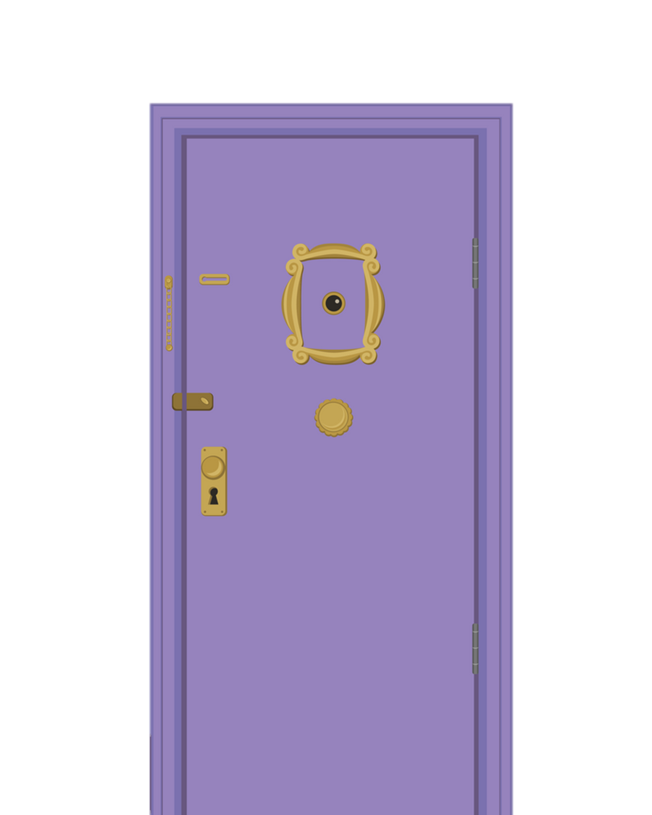


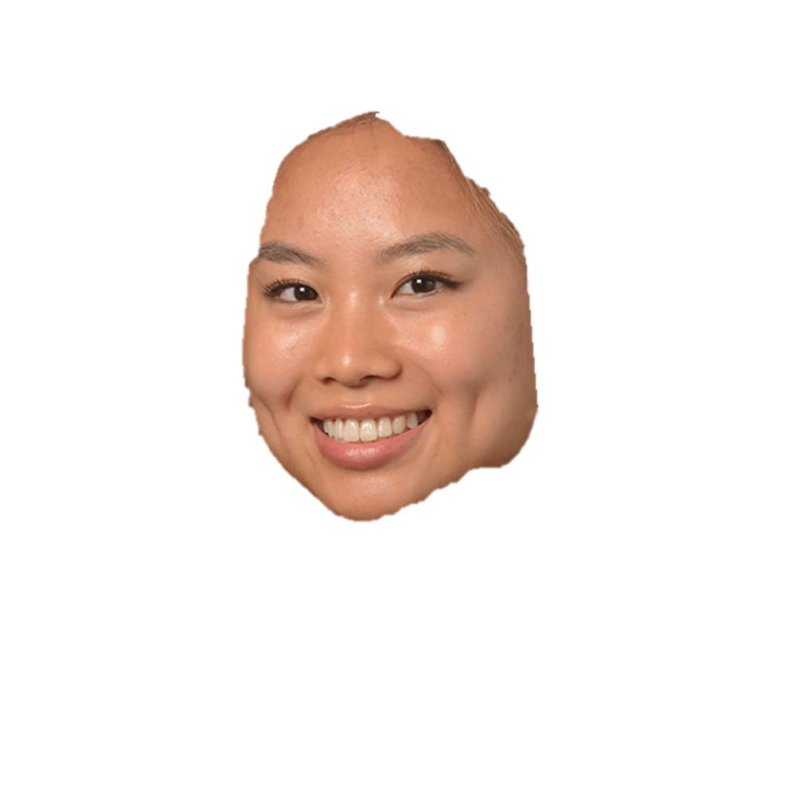




Could we BE analyzing any more scripts? A Text Analysis of the sitcom Friends
Blue 19
Nikhil Suthar, Cameron Bumgarner, Kathleen Dang, Kimberly Scheiber
10/20/2022

Slide 2
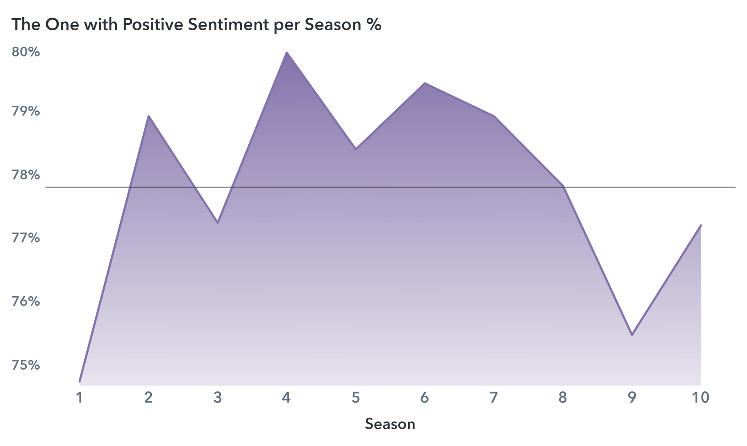
77.81%
Average Sentiment

Slide 3



TABLE OF CONTENTS
EDA
Initial Findings
Topic modeling
Character Affinity Analysis
Sentiment Analysis
Most positive and most negative character

Slide 4

Raw Data
228
50,509
6
episodes
dialogues
main characters

Slide 5
Data Preprocessing
Dialog Extraction
Scene Detail Removal
Sentence
Tokenization & Stop Word Removal
Porter Stemming

Slide 6
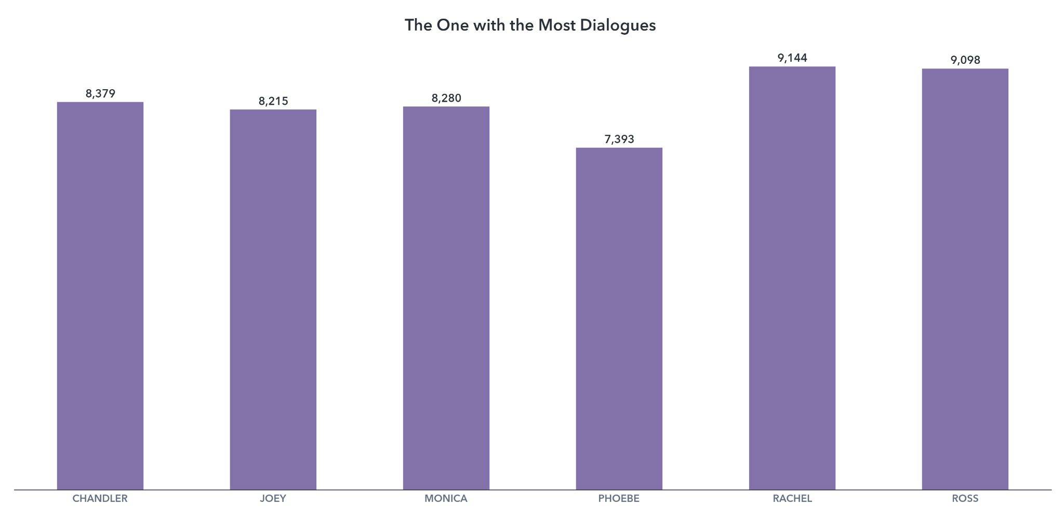

Slide 7

Topic MODELING

Slide 8




Topic Modeling
Topic modeling by season
Topic modeling by character
Character Affinity

Slide 9
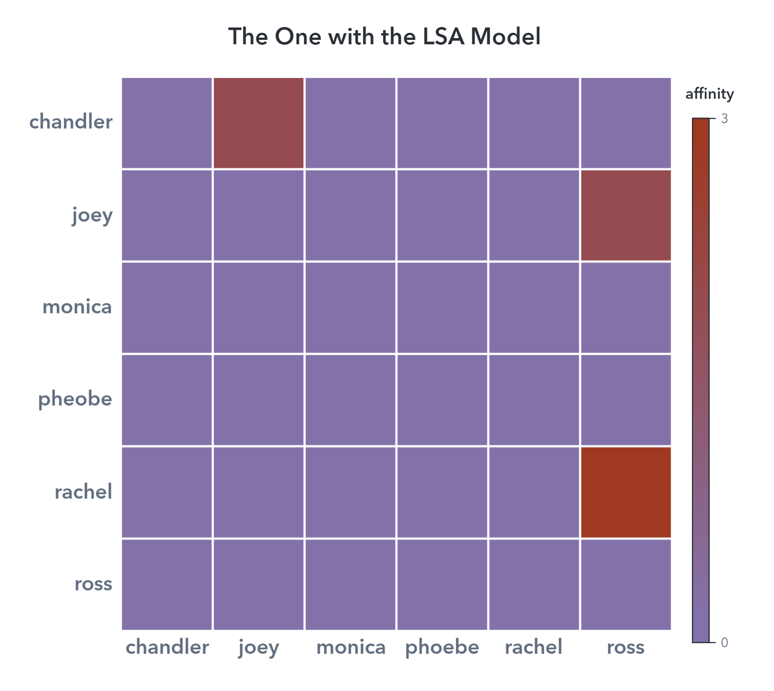
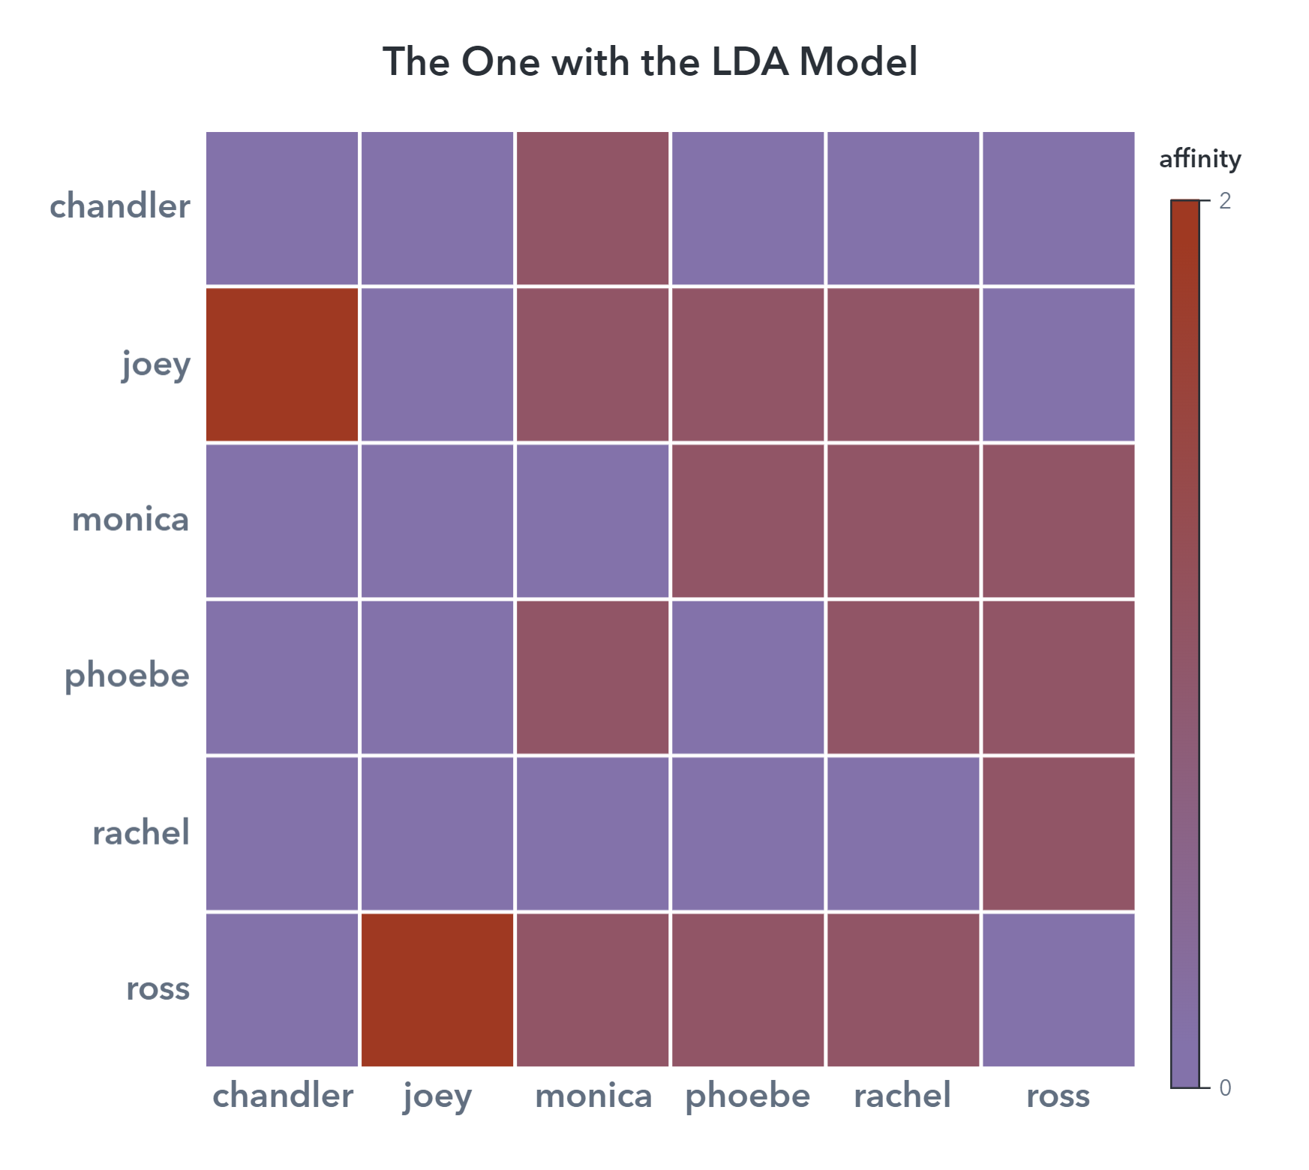

Slide 10

Sentiment Analysis

Slide 11
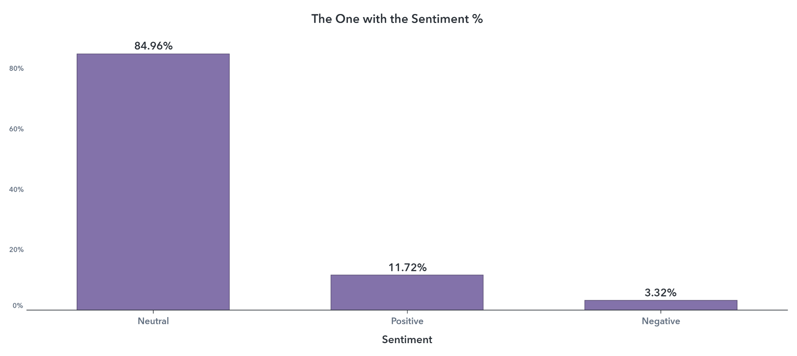

Slide 12
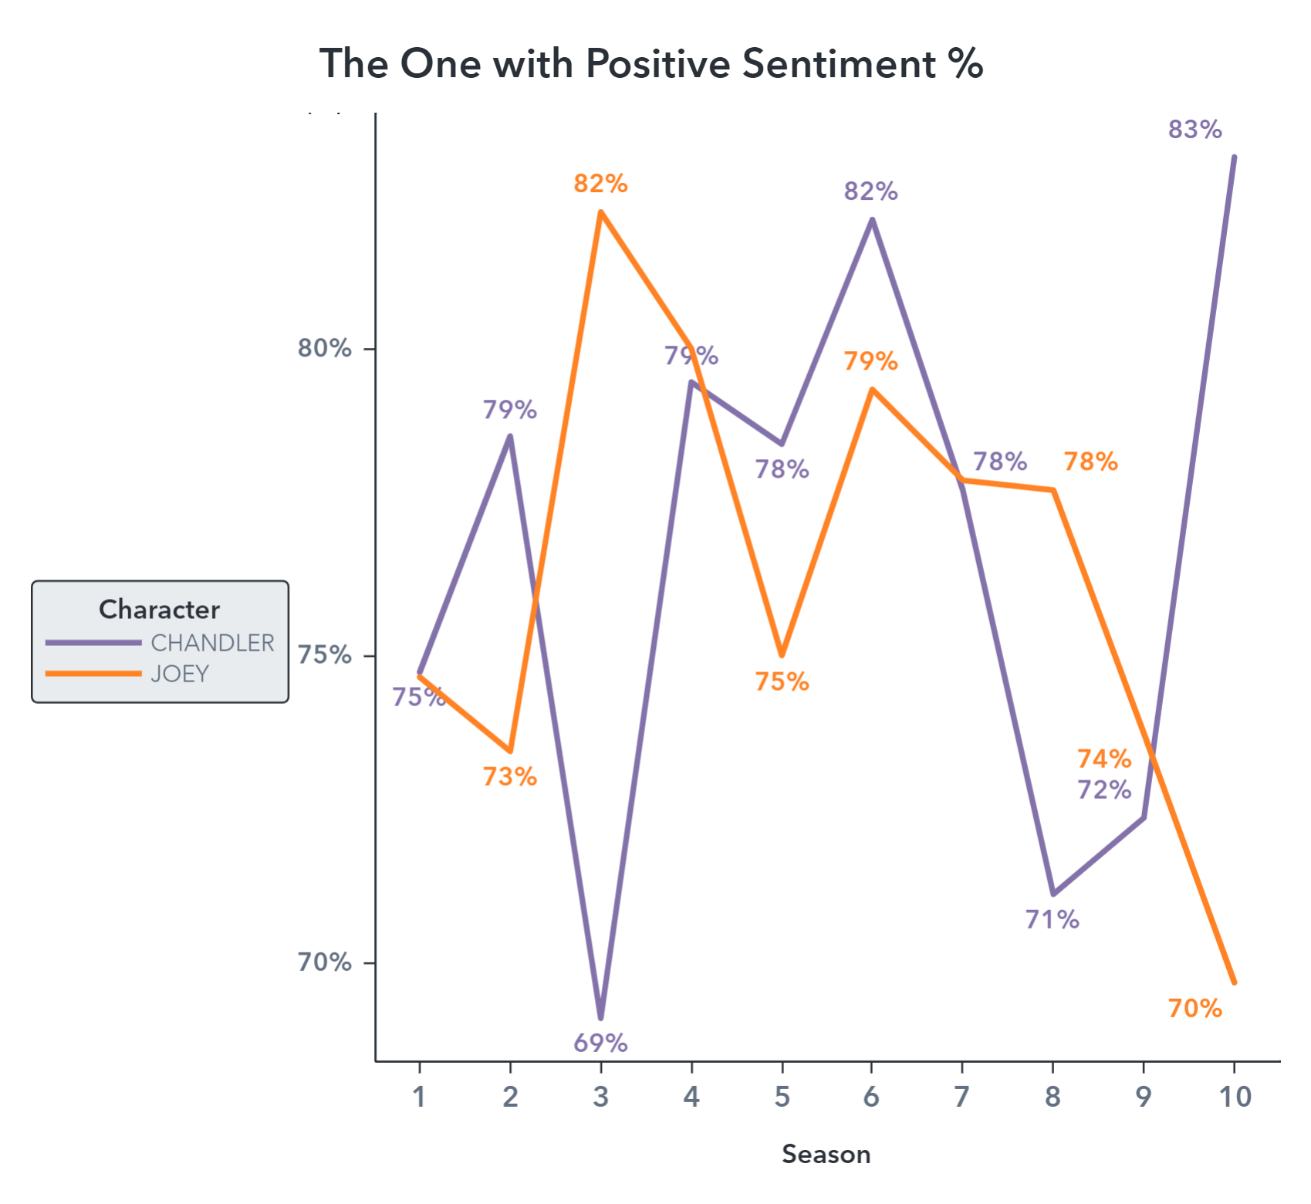

Slide 13
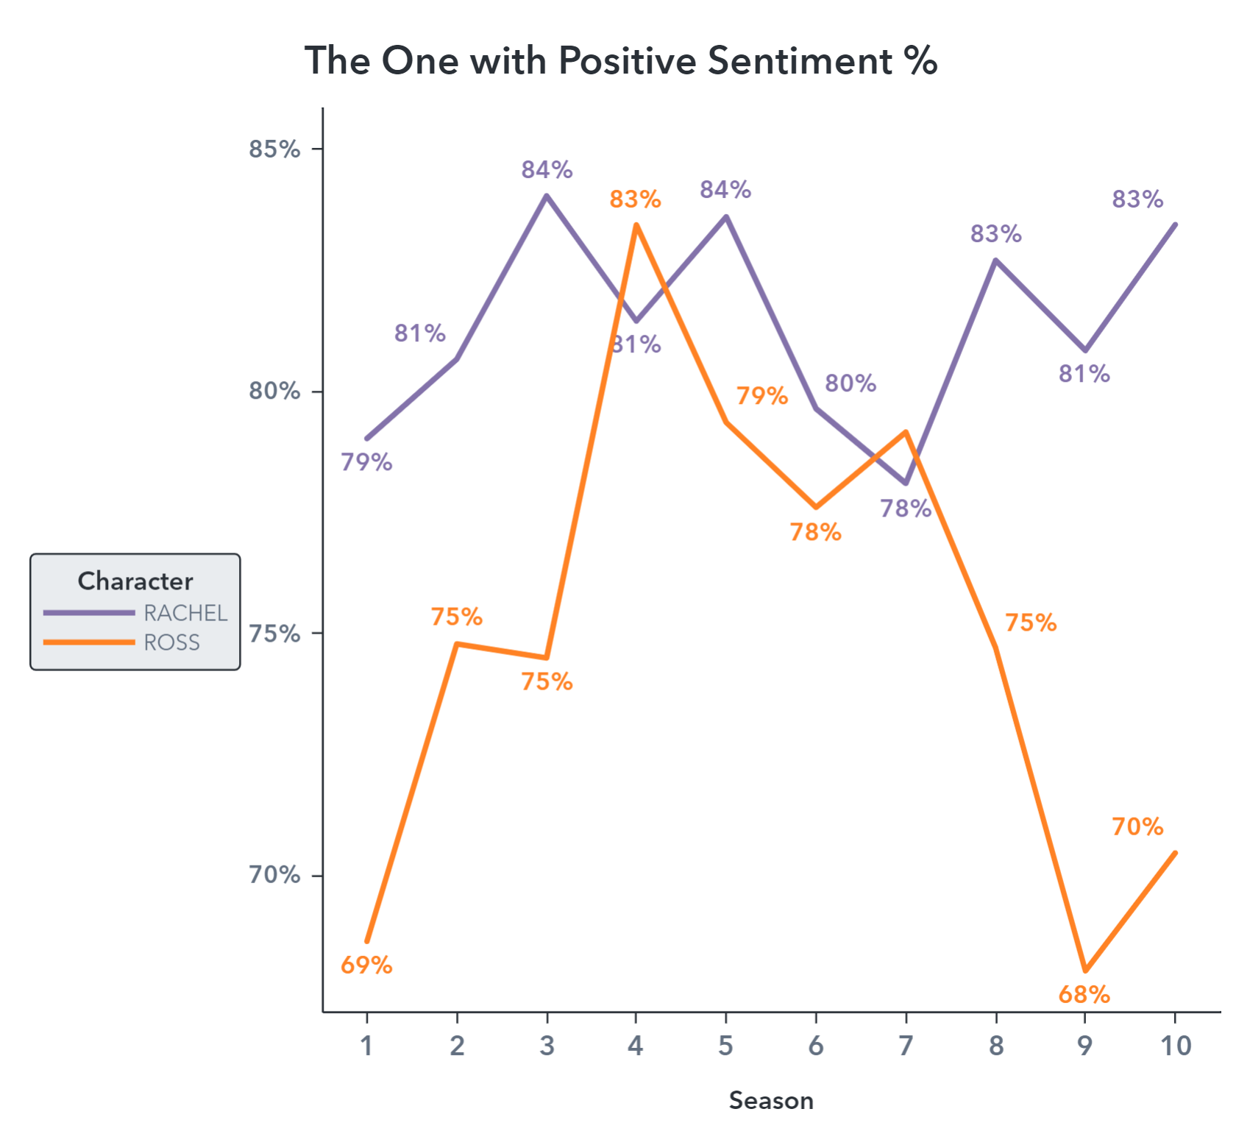

Slide 14
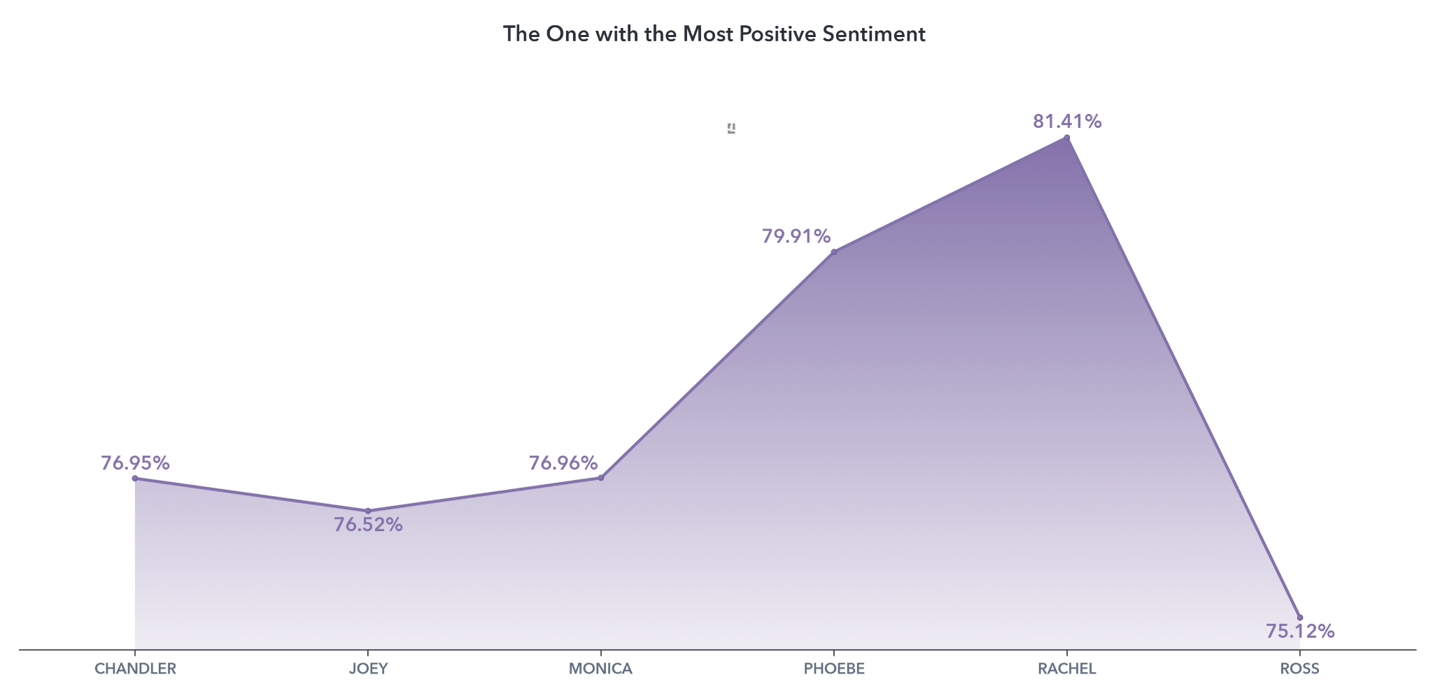

Slide 15
Q&A

Slide 16
THANKS!
Does anyone have any questions?
addyouremail@freepik.com
+91 620 421 838
yourcompany.com
Please keep this slide for attribution

Slide 17
APPENDIX

Slide 18
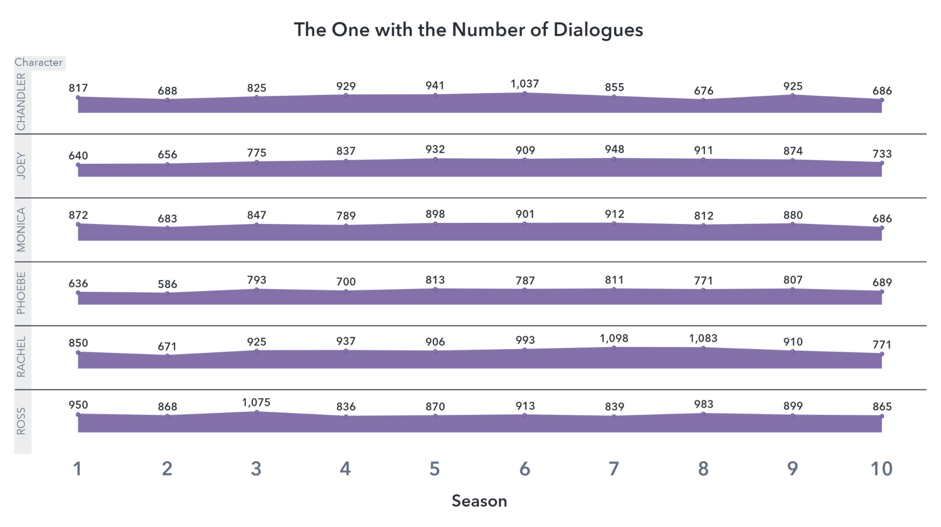

Slide 19


